Slide 1
Using Image Recognition Software for searching trademarks, industrial designs or trade dress & Legal Issues to Consider
Visual search tailored for Intellectual Property
Ryan Patterson - Sales Director/AI+Image Recognition specialist
Compumark - formerly TrademarkVision
Kent Erickson - Attorney
Erickson Kernell

Slide 2
TrademarkVision AI searching for trademarks
Law Firms + Corporates + Governments
Trademark searching using image recognition
Trademark monitoring using image recognition
3. Artwork tagging for licensing (Logoseer product)
4. Industrial Design/Trade Dress Search Engine

Slide 3
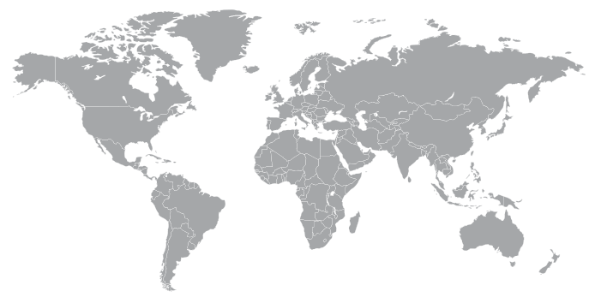
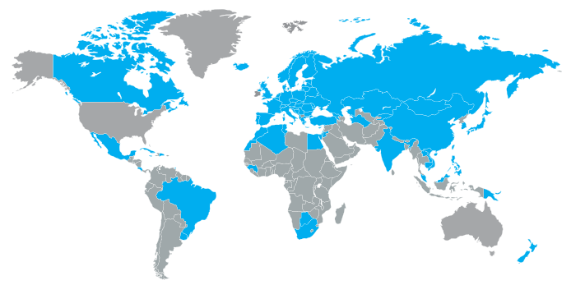
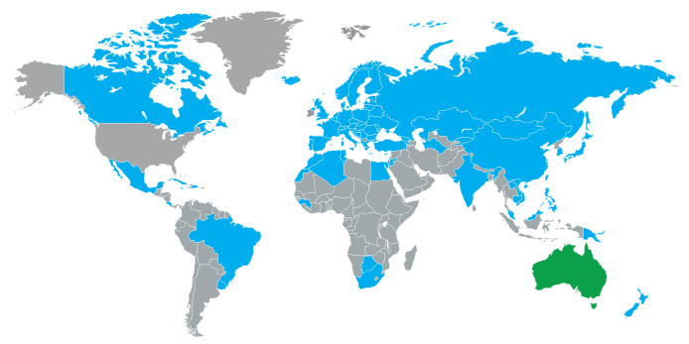
The global problem with searching for Design Trademarks
Design codes
Vienna codes
Keywords

Slide 4
Approach
Image recognition
High Level
Object Recognition
Object
Low Level
Pattern Recognition
Colour Independence
Grey Scale
Shape, Texture & Contour
Image
Pre-Processing
Optical Character Recognition
Variations (e.g. shading)
Segmentation

Slide 5
Governments
Innovative government partners
Work together with the governments to solve a global problem
Advanced AI-powered image recognition

Slide 6
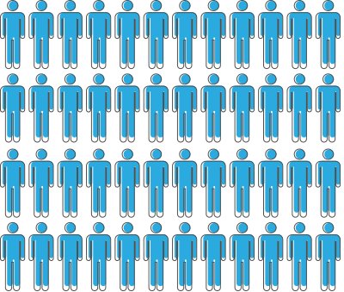
Powering governments
Hundreds of thousands
of searches conducted by the public on government partner search engines
More than 1000 per day
With EUIPO’s search engine alone

Slide 7
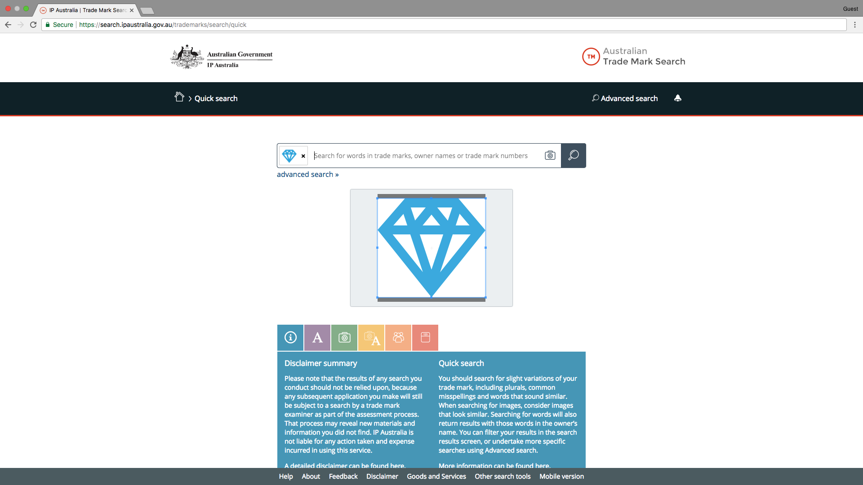
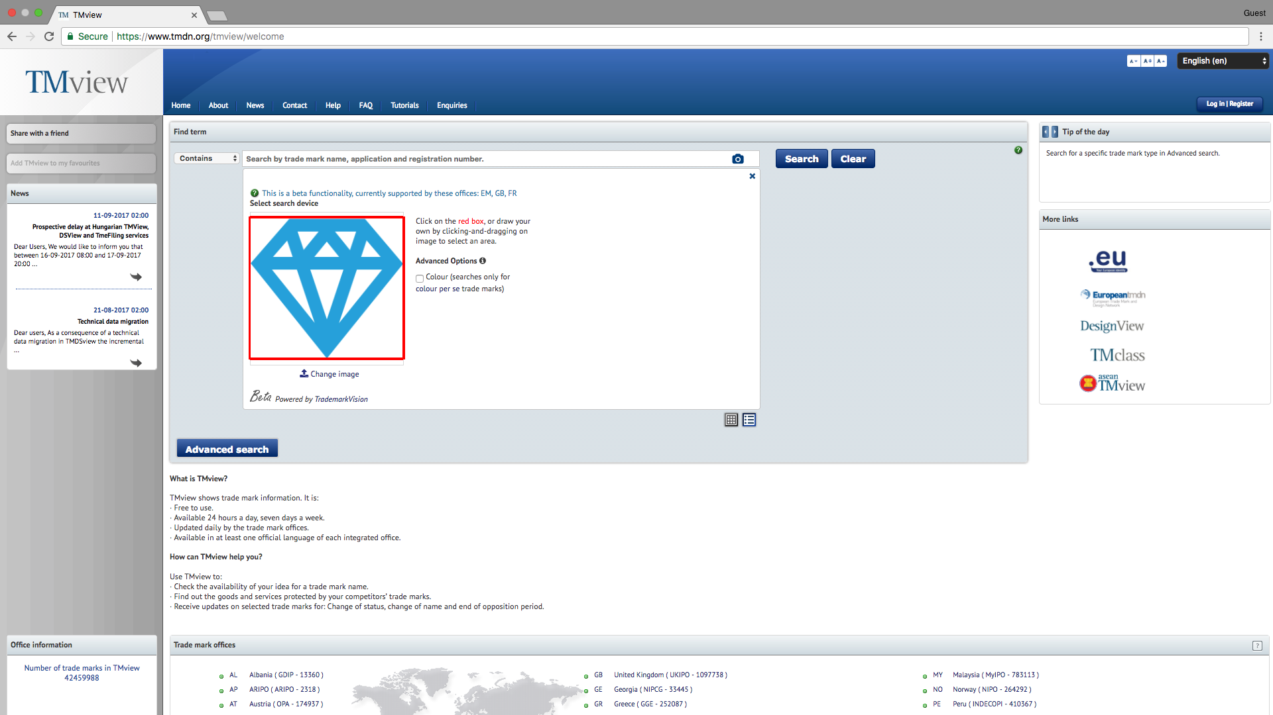
Powering governments

Slide 8
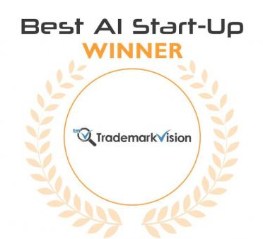
Artificial Intelligence and Machine Learning
Awards and Recognition
World’s Top 10
Most Innovative Companies
In AI/Machine Learning
Top 25 major machine learning vendors

Slide 9
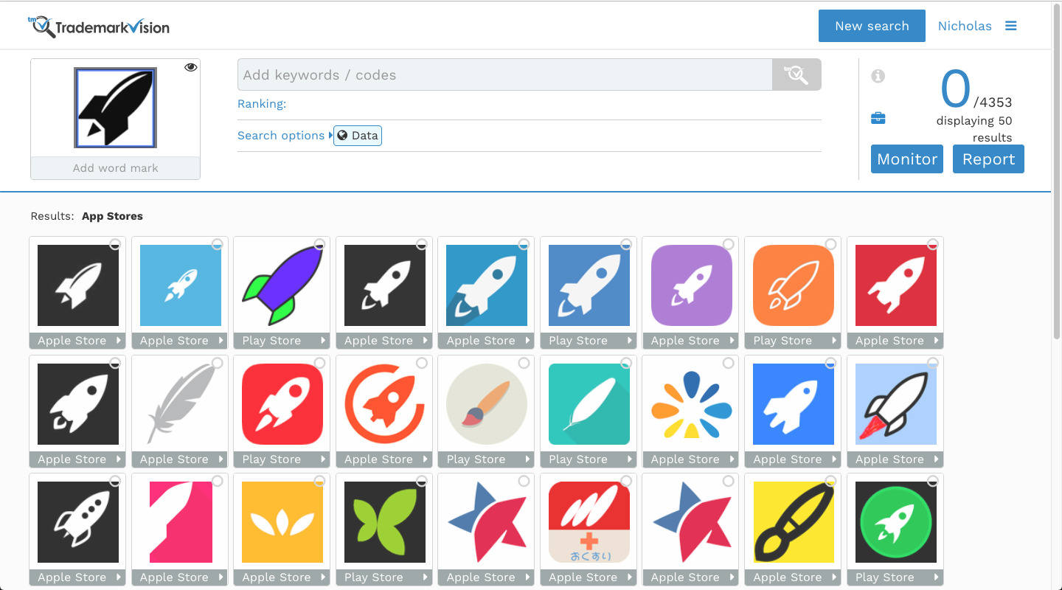
App Stores

Slide 10
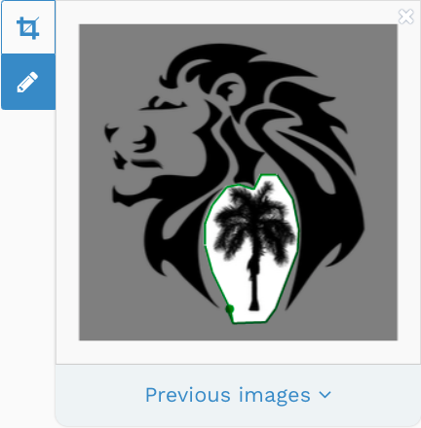
Advanced Tools
Lasso Tool - Select smaller figurative elements inside an image that cannot be selected with a square crop

Slide 11
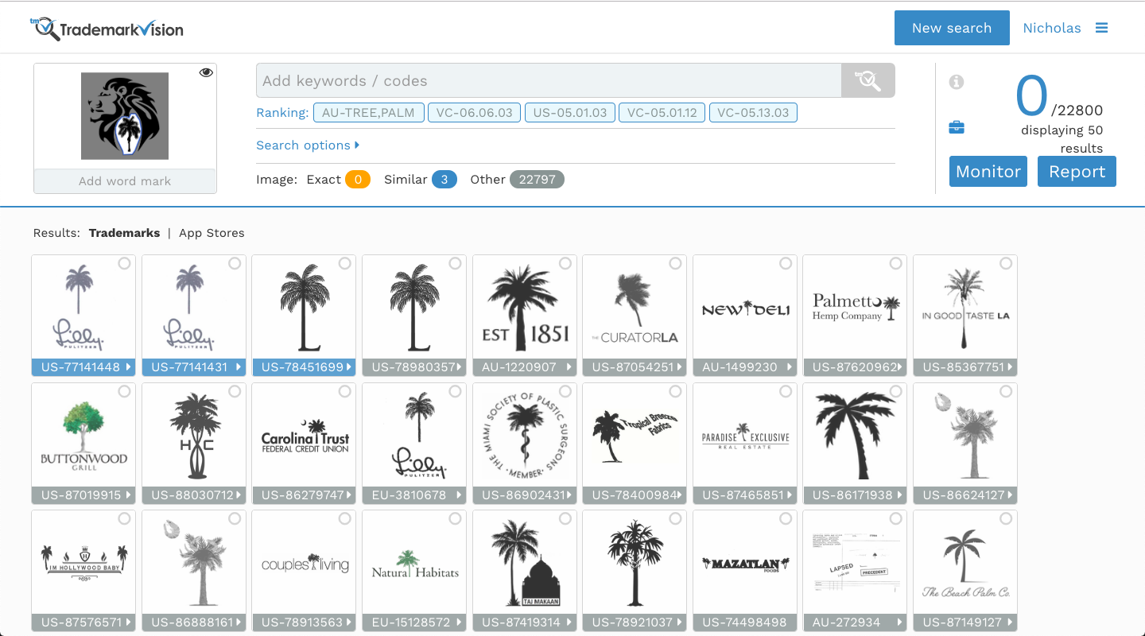

Slide 12
Image/Text Combination Searching
Currently, this allows a user to add a text element to an image search as an “and” search
The results will return anything that has the text component AND looks like the probe image
There are other ways to do this. But this is the best we have found so far
Exceptionally useful feature when it is needed
We use OCR to detect the text and offer it as a suggestion to the user
One potential issue is user confusion
Adding long or unusual text strings can quickly narrow the results too far

Slide 13
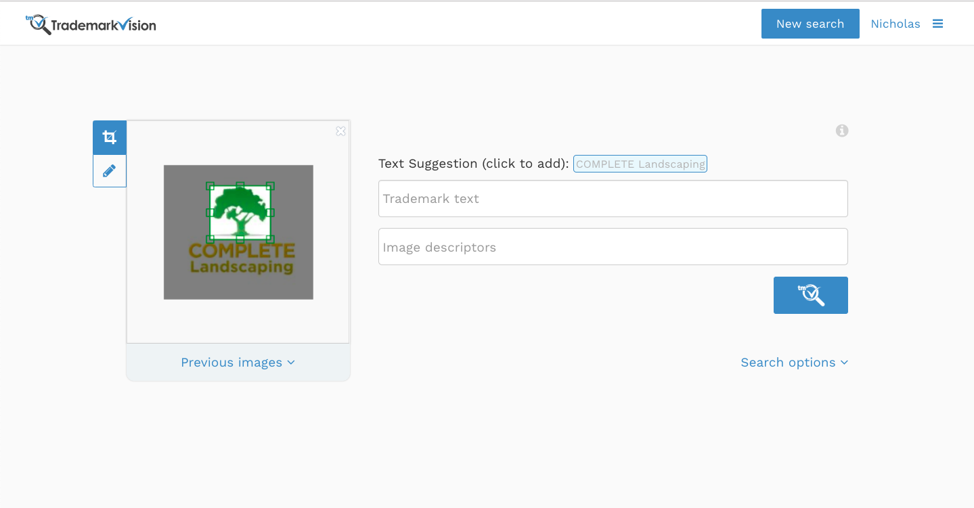

Slide 14
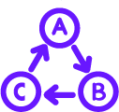
Changing Landscape, New Challenges
The need for Risk Mitigation has never been greater.
Rapidly Evolving Technology
Increasing Globalization
RISK
Shrinking Budgets
Explosion of Trademark Filings
Accelerated Timelines
More Brand Channels
Notes:
The global marketing landscape is changing.
Increasing globalization is driving economic activity worldwide.
This is creating an explosion of trademark filings. And increasing oppositions.
The number of channels is expanding, further increasing the risk of infringement, whether intentional or unintentional.
Rapidly evolving technology is creating new opportunities for brands—and for infringers and counterfeiters.
Litigation costs for infringement are high and rising, making due diligence for new brands critical.
And every day, this landscape is continuing to evolve rapidly.
Bottom line: The need for trademark risk mitigation has never been greater.

Slide 15
Screen Across the Entire Brand Spectrum
SCREENING
DOMAIN NAMES
COMPANY NAMES
200 million
212
and growing!
countries
PHARMA NAMES
INDUSTRIAL DESIGNS
70+
17
countries
countries
Access all databases or a custom combination.
Notes:
With SAEGIS, you can screen trademarks across the entire brand spectrum.
It provides “one stop” coverage of:
Millions of domain names
Company names from 212 countries
Pharmaceutical names from more than 70 countries
And industrial designs from 17 countries
Search across all of these databases, or create your own custom combination.

Slide 16
TM go365
CLEARANCE
TM
On-Demand Clearance
Superior Search Results
Best-of-breed Search
Technology
Trusted Content
Including Common Law
Results in Seconds
Word + Image Marks
Self-service Convenience & Control
Anytime, Anywhere Access
Risk Reduction Made Easy
Notes:
Our revolutionary TM go365 self-service, on-demand clearance solution hits the results that others miss.
It’s the only trademark research solution that offers the speed, convenience and simplicity of online self-service together with clearance-grade accuracy and completeness.
TM go365 brings together a unique combination of benefits:
Superior search results: In head-to-head tests, TM go365 delivered more relevant findings than leading competitive self-service search solutions. That means less risk of missing critical marks—reducing your risk of a costly conflict.
Best of breed search technology: Advanced Machine Learning technology, leveraging our decades of trademark research experience, performs in-depth analysis to deliver more relevant results than other online alternatives, in just seconds.
Trusted content: Unlike competing self-service search solutions, TM go365 provides common law coverage, including key industry-specific sources, in addition to trademark registration data—reducing your risk of missing important findings. CompuMark’s proprietary search database contains millions of records—all reviewed and error-corrected—for jurisdictions worldwide.
Results in seconds:
Clear marks quickly to keep pace with today’s accelerated brand launch schedules.
Clear word and image marks:
Consolidate your clearance searching to save time and effort.
Self-service convenience and control:
TM go365 is easy to use, with powerful decision support tools that help you make confident decisions quickly and efficiently. Easily iterate searches to get the most relevant results quickly.
Anytime, anywhere access:
Clear marks whenever and wherever it’s convenient for you.
Risk reduction made easy:
Reduce your risk of a costly conflict quickly and easily, without compromising quality.

Slide 17
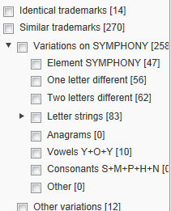
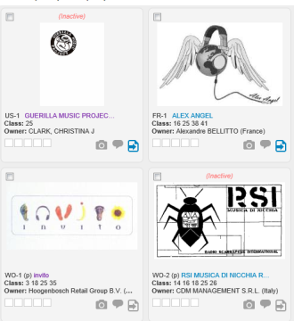
TM go365
CLEARANCE
TM
Transform Your Clearance Workflow
Fastest trademark clearance search in the industry
Advanced machine learning
Delivery of results on SERION®
Interactive tools to shape the results
Dashboard: report breakdown
Tools to sharpen search strategy
Visualization tools (e.g. tag cloud)
State-of-the-art search technology
Image recognition technology
Complex word variations
Advanced decision support tools
Notes:
TM go365 is designed to dramatically improve your trademark clearance workflow. Act quickly with the fastest clearance search available. Artificial intelligence-based algorithms zero in on relevant results in seconds. Access results quickly and conveniently in our SERION online trademark environment.
Innovative, interactive tools let you shape results as you go. A visual dashboard provides a breakdown of results at a glance.
Easy-to-use tools let you sharpen and refine your search strategy for greater precision.
Visualization tools like our Tag Cloud let you quickly zero in on the most critical findings.
TM go365 is powered by state-of-the-art technology, including image recognition technology.
Complex word variations provide unmatched precision.
And advanced decision support tools help you make informed decisions quickly.

Slide 18
TM go365™ Image Search
CLEARANCE
Drag. Drop. Go.
Groundbreaking image recognition technology
Matches image for image—no codes required!
Get ranked results in seconds
Algorithms based on years of machine learning
Trusted image content
Global data—10 million+ images
Indexed and cross-referenced
Identifies results others could miss
Notes:
A key advantage of TM go365 is its groundbreaking Image Search capability.
It uses advanced image recognition technology to match image for image, without using complex and imprecise design codes.
Just drag, drop and go. You get results ranked for relevancy in just seconds.
It’s able to do this thanks to sophisticated image recognition algorithms based on years of machine learning to ensure precision.
Plus, TM go 365 offers the advantage of trusted image content, tapping our global data of more than 10 million image marks.
This data is indexed and cross-referenced to provide the most accurate and complete results.
This helps TM go365 Image Search identify results that lesser tools could miss.

Slide 19
2018 Launched the World’s 1st AI powered Industrial Design and TradeDress Search Engine
R&D focused on several design challenges when moving to 3D instead of 2D searching
Multiple images per design
Perspective and rotation of images
Image type and resolution (Line Drawings, Photos, CAD)
Backgrounds not relevant to design

Slide 20
DesignVision

Slide 21
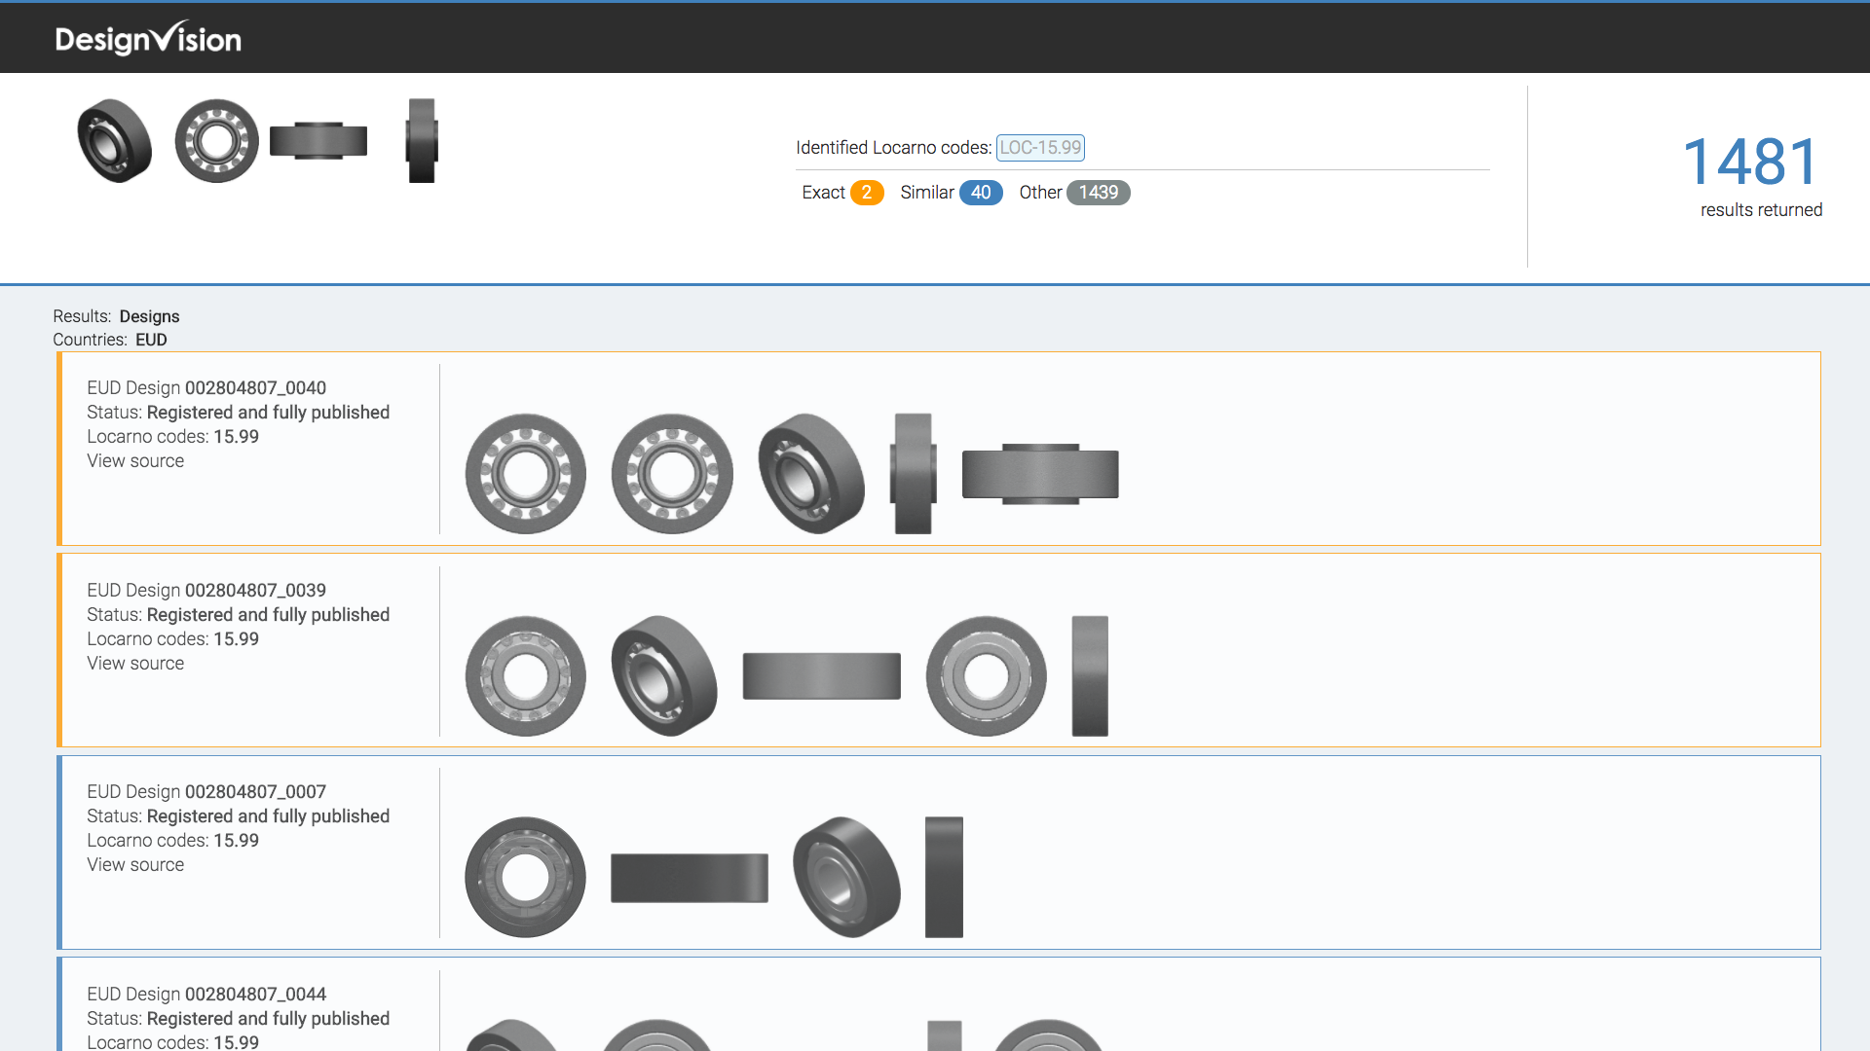

Slide 22
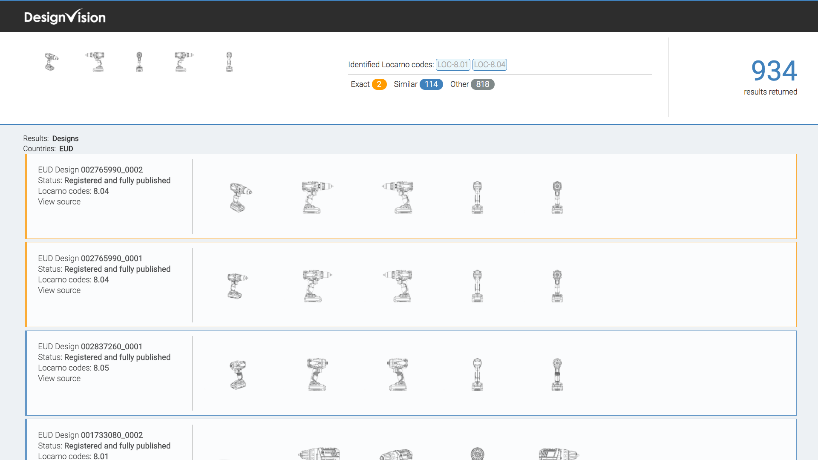

Slide 23
TrademarkVision set out to change the IP industry
using image recognition technology…
2019 and beyond
2011
2013
2015
2016
2017
2018
Spun-out cutting edge technology from Government research in computer vision.
Started exploring the problems of the world it could solve.
Released the world’s first visual search engine for trademarks.
Integration into EUIPO’s eSearch
TrademarkVision USA Launch
After years of research, implemented our first machine learning algorithms
IP Australia image search integration
Integrated into EU, UK and France through TMView.
Chile partnership
Launched the world’s 1st Industrial designs search in eSearch and IP Australia.
TrademarkVision acquired by Compumark
Spring 2019 Launched TMgo365 Industrial Design/TradeDress
TMgo365 Image launching for China soon….

Slide 24
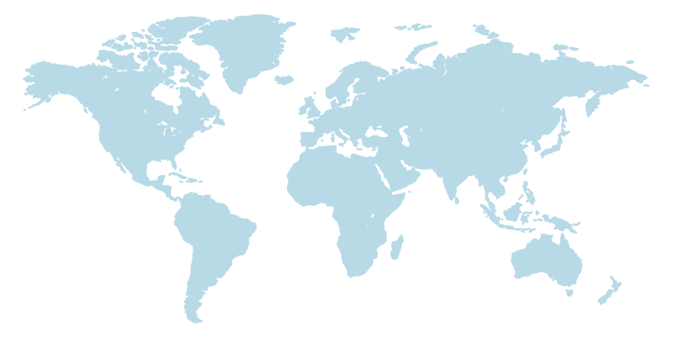
^{Ryan Patterson}
AI and Image Recognition Specialist
^{Ryan.Patterson@Clarivate.com}
⁽⁹⁷⁰⁾ ⁴⁰⁵ ⁻ ⁵¹¹⁴

